Slide 1

Credit Card Approval
By Anitha Poly

Slide 2
Agenda
Introduction
Problem Statement
Exploratory Data Analysis
Data Preprocessing
Model Development
Model Evaluation
Result
Conclusion

Slide 3
Introduction
In the financial sector, accepting credit cards is a critical procedure.
The financial institutions have to evaluate who applies for credit cards whether individuals or businesses
There are various factors to consider whether the applicant should offer a credit card.

Slide 4
Problem Statement
The primary objective of this project is to predict the approval or rejection of credit card applications.
The challenge lies in understanding the key factors influencing credit card approval decisions.
Building a predictive model to assist in the decision-making process.

Slide 5
Exploratory Data Analysis (EDA)
Exploratory data analysis (EDA) is used by data scientists to analyze and investigate data sets and summarize their main characteristics, often employing data visualization methods.
Performed EDA on the dataset,
Found valuable insights through data visualization, and summary statistics.
Performed Univariate and Bivariate analysis.

Slide 6
Data Preprocessing
Data preprocessing is a process of preparing the raw data and making it suitable for a machine learning model. It is the first and crucial step in creating a machine-learning model.
Prepared the data for model training by:
handling missing values
encoding categorical variables

Slide 7
Model Development
In this step, various machine learning models for classification, such as logistic regression, decision trees, and random forests are used.
Decision tree classifier, logistic regression, and random forest classifier are trained where an accuracy of 97%,98%, and 98% is obtained respectively.

Slide 8
Model Evaluation
Performed the model performance using appropriate evaluation metrics like accuracy, precision, recall, F1-score, confusion matrix, and ROC AUC.
Identified and analyzed the model which gave better accuracy.

Slide 9
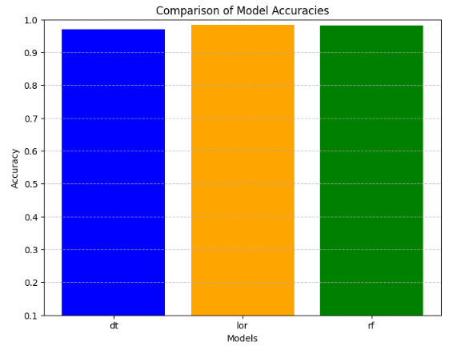
Result
Comparison between accuracies of decision tree, logistic regression and random forests

Slide 10
Conclusion
In this project decision tree, random forests, and logistic regression are used to predict whether the applicant will be given the credit card or not.
Random forests and logistic regression gave better accuracy than the other.
In the future, the accuracy can be improved by using other techniques.

Slide 11

Thank You

